Slide 1
Java Collection Framework

Slide 2
The Java collections framework provides a set of interfaces and classes to implement various data structures and algorithms.
For example, the LinkedList class of the collections framework provides the implementation of the doubly-linked list data structure.

Slide 3
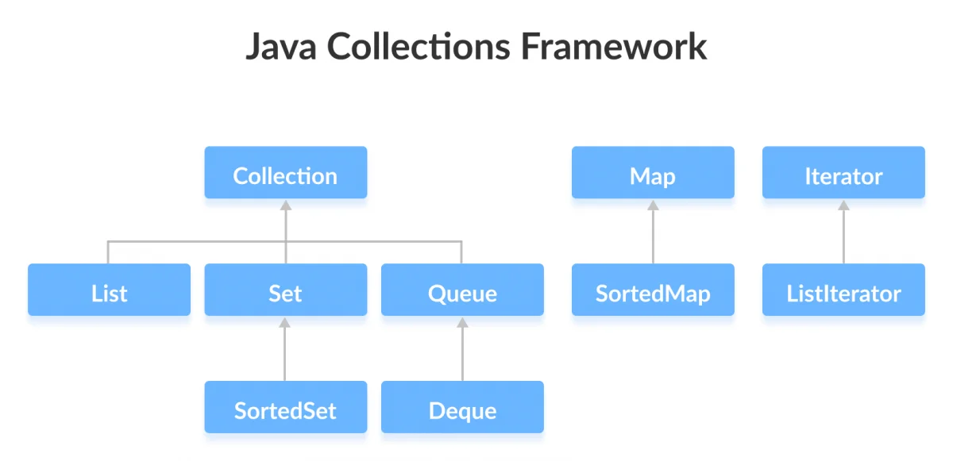
Interfaces of Collections Framework
The Java collections framework provides various interfaces. These interfaces include several methods to perform different operations on collections.

Slide 4
Java Collection Interface
The Collection interface is the root interface of the collections framework hierarchy.
Java does not provide direct implementations of the Collection interface but provides implementations of its subinterfaces like List, Set, and Queue.

Slide 5
Collections Framework Vs. Collection Interface
The Collection interface is the root interface of the collections framework. The framework includes other interfaces as well: Map and Iterator. These interfaces may also have subinterfaces.

Slide 6
Sub interfaces of the Collection Interface
As mentioned earlier, the Collection interface includes sub interfaces that are implemented by Java classes.
All the methods of the Collection interface are also present in its sub interfaces.

Slide 7
subinterfaces of the Collection Interface cont..
Here are the subinterfaces of the Collection Interface:
List Interface
The List interface is an ordered collection that allows us to add and remove elements like an array.
Set Interface
The Set interface allows us to store elements in different sets similar to the set in mathematics. It cannot have duplicate elements.
Queue Interface
The Queue interface is used when we want to store and access elements in First In, First Out manner.

Slide 8
Java Map Interface
In Java, the Map interface allows elements to be stored in key/value pairs. Keys are unique names that can be used to access a particular element in a map. And, each key has a single value associated with it.

Slide 9
Java Iterator Interface
In Java, the Iterator interface provides methods that can be used to access elements of collections.

Slide 10
Why the Collections Framework?
The Java collections framework provides various data structures and algorithms that can be used directly. This has two main advantages:
We do not have to write code to implement these data structures and algorithms manually.
Our code will be much more efficient as the collections framework is highly optimized.
Moreover, the collections framework allows us to use a specific data structure for a particular type of data. Here are a few examples,
If we want our data to be unique, then we can use the Set interface provided by the collections framework.
To store data in key/value pairs, we can use the Map interface.
The ArrayList class provides the functionality of resizable arrays.

Slide 11
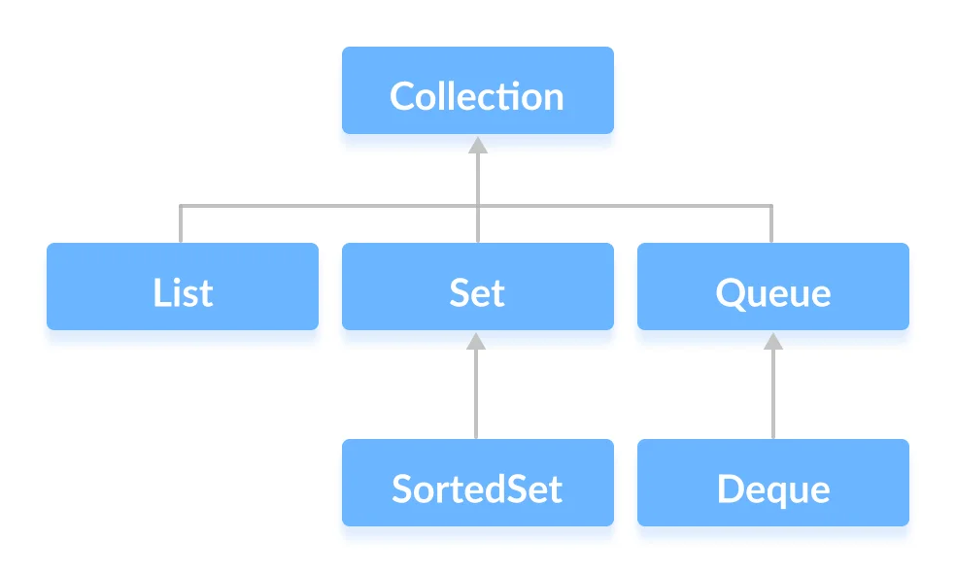
Java Collection Interface
The Collection interface is the root interface of the Java collections framework.
There is no direct implementation of this interface. However, it is implemented through its subinterfaces like List, Set, and Queue.
For example, the ArrayList class implements the List interface which is a subinterface of the Collection Interface.

Slide 12
Methods of Collection
The Collection interface includes various methods that can be used to perform different operations on objects. These methods are available in all its subinterfaces.
add() - inserts the specified element to the collection
size() - returns the size of the collection
remove() - removes the specified element from the collection
iterator() - returns an iterator to access elements of the collection
addAll() - adds all the elements of a specified collection to the collection
removeAll() - removes all the elements of the specified collection from the collection
clear() - removes all the elements of the collection

Slide 13
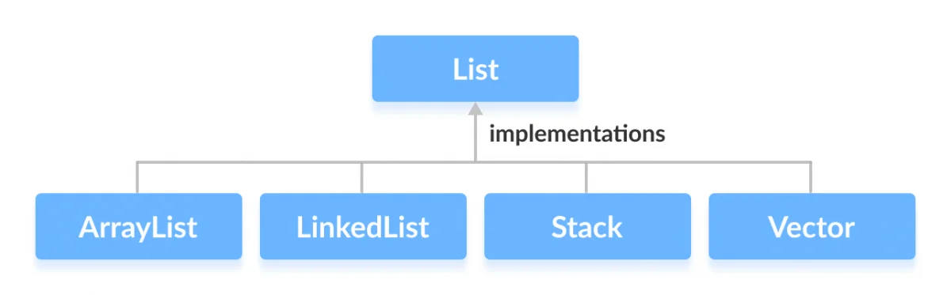
Java List Interface
In Java, the List interface is an ordered collection that allows us to store and access elements sequentially. It extends the Collection interface.
Since List is an interface, we cannot create objects from it.
In order to use functionalities of the List interface, we can use these classes.
These classes are defined in the Collections framework and implement the Listinterface.

Slide 14
How to use List?
In Java, we must import java.util.List package in order to use List.
// ArrayList implementation of List
List<String> list1 = new ArrayList<>();
// LinkedList implementation of List
List<String> list2 = new LinkedList<>();

Slide 15
Methods of List
The List interface includes all the methods of the Collection interface. Its because Collection is a super interface of List.
Some of the commonly used methods of the Collection interface that's also available in the List interface are:
add() - adds an element to a list
addAll() - adds all elements of one list to another
get() - helps to randomly access elements from lists
iterator() - returns iterator object that can be used to sequentially access elements of lists
set() - changes elements of lists

Slide 16
remove() - removes an element from the list
removeAll() - removes all the elements from the list
clear()- removes all the elements from the list (more efficient than removeAll())
size()- returns the length of lists
toArray() - converts a list into an array
contains() - returns true if a list contains specified element.

Slide 17
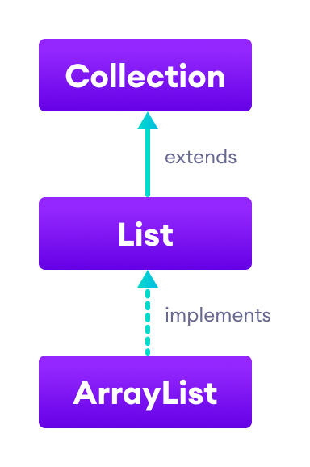
Java ArrayList
In Java, we use the ArrayList class to implement the functionality of resizable-arrays.
It implements the List interface of the collections framework.

Slide 18
Java ArrayList Vs Array
In Java, we need to declare the size of an array before we can use it. Once the size of an array is declared, it's hard to change it.
To handle this issue, we can use the ArrayList class. It allows us to create resizable arrays.
Unlike arrays, arraylists can automatically adjust their capacity when we add or remove elements from them. Hence, arraylists are also known as dynamic arrays.

Slide 19
Creating an ArrayList
Before using ArrayList, we need to import the java.util.ArrayList package first.
Type indicates the type of an arraylist.
Note: we cannot use primitive types while creating an arraylist. Instead, we have to use the corresponding wrapper classes.
ArrayList<Type> arrayList= new ArrayList<>();
// create Integer type arraylist
ArrayList<Integer> arrayList = new ArrayList<>();
// create String type arraylist
ArrayList<String> arrayList = new ArrayList<>();

Slide 20
Create ArrayList in Java
import java.util.ArrayList;
class Main {
public static void main(String[] args){
// create ArrayList
ArrayList<String> names = new ArrayList<>();
// Add elements to ArrayList
names.add(”Swaraj");
names.add("Prashant");
names.add(”Gokul");
System.out.println("ArrayList: " + names);
}
}

Slide 21
Basic Operations on ArrayList
Add elements
Access elements
Change elements
Remove elements

Slide 22
Example
import java.util.ArrayList;
class Main {
public static void main(String[] args){
// create ArrayList
ArrayList<String> languages = new ArrayList<>();
//add() method without the index parameter
languages.add("Java");
languages.add("C");
languages.add("Python");
System.out.println("ArrayList: " + languages);
// add JavaScript at index 3
languages.add(3,"C++");
// get the element from the arraylist
String str = languages.get(1);
System.out.print("Element at index 1: " + str);
// change the element of the array list
languages.set(2, "JavaScript");
System.out.println("Modified ArrayList: " + languages);
}
}

Slide 23
Remove ArrayList Elements
To remove an element from the arraylist, we can use the remove() method of the ArrayList class.
import java.util.ArrayList;
class Main {
public static void main(String[] args) {
ArrayList<String> animals = new ArrayList<>();
// add elements in the array list
animals.add("Dog");
animals.add("Cat");
animals.add("Horse");
System.out.println("ArrayList: " + animals);
// remove element from index 2
String str = animals.remove(2);
System.out.println("Updated ArrayList: " + animals);
System.out.println("Removed Element: " + str);
}
}
The remove() method takes the index number as the parameter. And, removes the element specified by the index number.

Slide 24
Java ArrayList removeAll()
The syntax of the removeAll() method is:
collection -all elements present in collection are deleted from the arraylist.
returns true if elements are deleted from the arraylist.
throws ClassCastException if the class of elements present in arraylist is incompatible with the class of elements in specified collection.
throws NullPointerException if the arraylist contains null element and the specified collection does not allow null elements.
arraylist.removeAll(Collection c);

Slide 25
Example
import java.util.ArrayList;
class Main {
public static void main(String[] args){
// create an arraylist
ArrayList<String> languages = new ArrayList<>();
// add elements to arraylist
languages.add("Java");
languages.add("JavaScript");
languages.add("Python");
System.out.println("Programming Languages: " + languages);
// remove all elements from arraylist
languages.removeAll(languages);
System.out.println("ArrayList after removeAll(): " + languages);
}
}

Slide 26
Remove all Elements from an ArrayList Present in Another ArrayList
import java.util.ArrayList;
class Main {
public static void main(String[] args) {
// create an ArrayList
ArrayList<String> languages1 = new ArrayList<>();
// insert element at the end of arraylist
languages1.add("Java");
languages1.add("English");
languages1.add("C");
languages1.add("Spanish");
System.out.println("Languages1: " + languages1);
// create another arraylist
ArrayList<String> languages2 = new ArrayList<>();
// add elements to the arraylist
languages2.add("English");
languages2.add("Spanish");
System.out.println("Languages2: " + languages2);
// remove all elements of ArrayList2 from ArrayList1
languages1.removeAll(languages2);
System.out.println("Languages1 after removeAll(): " + languages1);
}
}

Slide 27
Write a java program to accept n number of city. Insert into array list collection and display the content of the same array list, remove all this element use (clear ()) method
import java.util.ArrayList;
import java.util.Scanner;
public class ArrayListCity {
public static void main(String[] args) {
Scanner sc = new Scanner(System.in);
ArrayList<String> list = new ArrayList<>();
System.out.printf("\n Total Number of city:");
int n = sc.nextInt();
for(int i=0;i<n;i++)
{
System.out.printf("\n Enter city name:");
String city = sc.next();
list.add(city);
}
System.out.println("\n Array List contains:"+ list);
list.clear();
System.out.printf("\n After using clear method:");
System.out.println("\n Array List contains:"+ list);
}
}

Slide 28
Java ArrayList clear()
arraylist.clear()
Both the removeAll() and clear() method are performing the same task. However, the clear() method is used more than removeAll(). It is because clear() is faster and efficient compared to removeAll().

Slide 29
Methods of ArrayList Class
Methods | Descriptions
size() | Returns the length of the arraylist.
sort() | Sort the arraylist elements.
clone() | Creates a new arraylist with the same element, size, and capacity.
contains() | Searches the arraylist for the specified element and returns a boolean result.
ensureCapacity() | Specifies the total element the arraylist can contain.
isEmpty() | Checks if the arraylist is empty.
indexOf() | Searches a specified element in an arraylist and returns the index of the element.

Slide 30
size()
import java.util.ArrayList;
class Main {
public static void main(String[] args) {
// create an ArrayList
ArrayList<Integer> primeNumbers = new ArrayList<>();
primeNumbers.add(2);
primeNumbers.add(3);
primeNumbers.add(5);
primeNumbers.add(7);
System.out.println("ArrayList: " + primeNumbers);
// get the number of elements of arraylist
int size = primeNumbers.size();
System.out.println("Length of ArrayList: " + size);
}
}
// Output: ArrayList: [2, 3, 5, 7]
// Length of ArrayList: 4
isEmpty()
import java.util.ArrayList;
class Main {
public static void main(String[] args) {
// create an ArrayList
ArrayList<String> languages = new ArrayList<>();
System.out.println("Newly Created ArrayList: " + languages);
// checks if the ArrayList has any element
boolean result = languages.isEmpty(); // true
System.out.println("Is the ArrayList empty? " + result);
// add some elements to the ArrayList
languages.add("Python");
languages.add("Java");
System.out.println("Updated ArrayList: " + languages);
// checks if the ArrayList is empty
result = languages.isEmpty(); // false
System.out.println("Is the ArrayList empty? " + result);
}
}

Slide 31
Java ArrayList indexOf()
Syntax:
obj - element whose position is to be returned
If the same element obj is present in multiple location, then the position of the element that appears first in the arraylist is returned.
Note: If the specified element doesn't exist in the list, the indexOf() method returns -1.
arraylist.indexOf(Object obj)
import java.util.ArrayList;
class Main {
public static void main(String[] args) {
// create an ArrayList
ArrayList<Integer> numbers = new ArrayList<>();
// insert element to the arraylist
numbers.add(22);
numbers.add(13);
numbers.add(35);
System.out.println("Number ArrayList: " + numbers);
// find the position of 13
int position1 = numbers.indexOf(13);
System.out.println("Index of 13: " + position1);
// find the position of 50
int position2 = numbers.indexOf(50);
System.out.println("Index of 50: " + position2);
}
}

Slide 32
Java ArrayList sort()
Syntax:
comparator - specifies the sort order of the arraylist.
For Ascending Order: Comparator.naturalOrder()
For Reverse Order: Comparator.reverseOrder()
The sort() method does not return any value. Rather it only changes the order of elements in an arraylist.
import java.util.ArrayList;
import java.util.Comparator;
class Main {
public static void main(String[] args) {
// create an ArrayList
ArrayList<String> languages = new ArrayList<>();
// add elements to ArrayList
languages.add("Python");
languages.add("Swift");
languages.add("C");
languages.add("JavaScript");
System.out.println("Unsorted ArrayList: " + languages);
// sort the ArrayList in ascending order
languages.sort(Comparator.naturalOrder());
System.out.println("Sorted ArrayList: " + languages);
}
}
arraylist.sort(Comparator c)

Slide 33
Java ArrayList clone()
Syntax:
returns a copy of the ArrayList object
arraylist.clone()
import java.util.ArrayList;
class Main {
public static void main(String[] args){
// create an arraylist
ArrayList<Integer> number = new ArrayList<>();
number.add(1);
number.add(3);
number.add(5);
System.out.println("ArrayList: " + number);
// create copy of number
ArrayList<Integer> cloneNumber = (ArrayList<Integer>)number.clone();
System.out.println("Cloned ArrayList: " + cloneNumber);
}
}

Slide 34
Java ArrayList contains()
Syntax:
obj - element that is checked if present in the arraylist
returns true if the specified element is present in the arraylist.
returns false if the specified element is not present in the arraylist.
import java.util.ArrayList;
class Main {
public static void main(String[] args) {
// create an ArrayList
ArrayList<Integer> numbers = new ArrayList<>();
// insert element to the arraylist
numbers.add(2);
numbers.add(3);
numbers.add(5);
System.out.println("Number ArrayList: " + numbers);
// checks if 3 is present in the arraylist
System.out.print("Is 3 present in the arraylist: ");
System.out.println(numbers.contains(3));
// checks if 1 is present in the arraylist
System.out.print("Is 1 present in the arraylist: ");
System.out.println(numbers.contains(1));
}
}
arraylist.contains(Object obj)

Slide 35
Java ArrayList ensureCapacity()
Syntax:
minCapacity - the specified minimum capacity of the arraylist
arraylist.ensureCapacity(int minCapacity)
import java.util.ArrayList;
class Main {
public static void main(String[] args) {
ArrayList<String> languages= new ArrayList<>();
// set the capacity of the arraylist
languages.ensureCapacity(3);
// Add elements in the ArrayList
languages.add("Java");
languages.add("Python");
languages.add("C");
System.out.println("ArrayList: " + languages);
}
}

Slide 36
Iterate through an ArrayList
import java.util.ArrayList;
class Main {
public static void main(String[] args) {
// creating an array list
ArrayList<String> animals = new ArrayList<>();
animals.add("Cow");
animals.add("Cat");
animals.add("Dog");
System.out.println("ArrayList: " + animals);
// iterate using for-each loop
System.out.println("Accessing individual elements: ");
for (String language : animals) {
System.out.print(language);
System.out.print(", ");
}
}
}

Slide 37
ArrayList to Array
Array to ArrayList
import java.util.ArrayList;
class Main {
public static void main(String[] args) {
ArrayList<String> languages = new ArrayList<>();
// add elements in the array list
languages.add("Java");
languages.add("Python");
languages.add("C++");
System.out.println("ArrayList: " + languages);
// create a new array of String type
String[] arr = new String[languages.size()];
// convert ArrayList into an array
languages.toArray(arr);
System.out.print("Array: ");
// access elements of the array
for (String item : arr) {
System.out.print(item + ", ");
}
}
}
import java.util.ArrayList;
import java.util.Arrays;
class Main {
public static void main(String[] args) {
// create an array of String type
String[] arr = { "Java", "Python", "C++" };
System.out.print("Array: ");
// print array
for (String str : arr) {
System.out.print(str);
System.out.print(" ");
}
// create an ArrayList from an array
ArrayList<String> languages = new ArrayList<>(Arrays.asList(arr));
System.out.println("\nArrayList: " + languages);
}
}

Slide 38
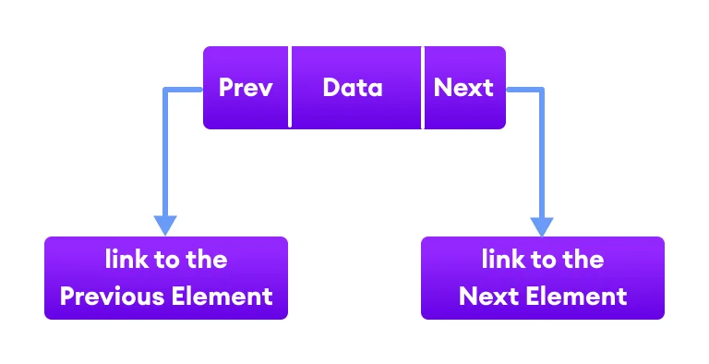
Java LinkedList
The LinkedList class of the Java collections framework provides the functionality of the linked list data structure (doubly linkedlist).
Each element in a linked list is known as a node. It consists of 3 fields:
Prev - stores an address of the previous element in the list. It is null for the first element.
Next - stores an address of the next element in the list. It is null for the last element.
Data - stores the actual data.

Slide 39
Creating a Java LinkedList
Syntax:
Here, Type indicates the type of a linked list.
LinkedList<Type> linkedList = new LinkedList<>();
// create Integer type linked list
LinkedList<Integer> linkedList = new LinkedList<>();
// create String type linked list
LinkedList<String> linkedList = new LinkedList<>();

Slide 40
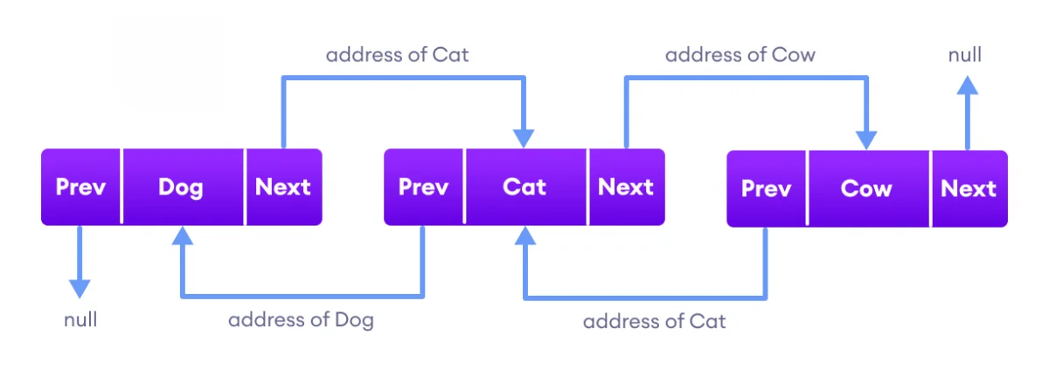
Working of a Java LinkedList
Elements in linked lists are not stored in sequence. Instead, they are scattered and connected through links (Prev and Next).
Here we have 3 elements in a linked list.
Dog - it is the first element that holds null as previous address and the address of Cat as the next address
Cat - it is the second element that holds an address of Dog as the previous address and the address of Cow as the next address
Cow - it is the last element that holds the address of Cat as the previous address and null as the next element

Slide 41
Since the LinkedList class also implements the Queue and the Deque interface, it can implement methods of these interfaces as well. Here are some of the commonly used methods:

Slide 42
Java Vector
The Vector class is an implementation of the List interface that allows us to create resizable-arrays similar to the ArrayList class.
In Java, both ArrayList and Vector implements the List interface and provides the same functionalities. However, there exist some differences between them.
The Vector class synchronizes each individual operation. This means whenever we want to perform some operation on vectors, the Vector class automatically applies a lock to that operation.
It is because when one thread is accessing a vector, and at the same time another thread tries to access it, an exception called ConcurrentModificationException is generated. Hence, this continuous use of lock for each operation makes vectors less efficient.
However, in array lists, methods are not synchronized. Instead, it uses the Collections.synchronizedList() method that synchronizes the list as a whole.

Slide 43
Creation of Vector
Syntax:
Vector<Type> vector = new Vector<>();
// create Integer type linked list Vector<Integer> vector= new Vector<>();
// create String type linked list Vector<String> vector= new Vector<>();

Slide 44
Methods of Vector
Add Elements to Vector
add(element) - adds an element to vectors.
add(index, element) - adds an element to the specified position.
addAll(vector) - adds all elements of a vector to another vector.
Access Vector Elements
get(index) - returns an element specified by the index
iterator() - returns an iterator object to sequentially access vector elements

Slide 45
Iterator object to sequentially access vector elements
import java.util.Iterator;
import java.util.Vector;
class Main {
public static void main(String[] args) {
Vector<String> animals= new Vector<>();
animals.add("Dog");
animals.add("Horse");
animals.add("Cat");
// Using get()
String element = animals.get(2);
System.out.println("Element at index 2: " + element);
// Using iterator()
Iterator<String> iterate = animals.iterator();
System.out.print("Vector: ");
while(iterate.hasNext()) {
System.out.print(iterate.next());
System.out.print(", ");
}
}
}

Slide 46
Remove Vector Elements
remove(index) - removes an element from specified position
removeAll() - removes all the elements
clear() - removes all elements. It is more efficient than removeAll()
Others Vector Methods
Methods | Descriptions
set() | changes an element of the vector
size() | returns the size of the vector
toArray() | converts the vector into an array
toString() | converts the vector into a String
contains() | searches the vector for specified element and returns a boolean result

Slide 47
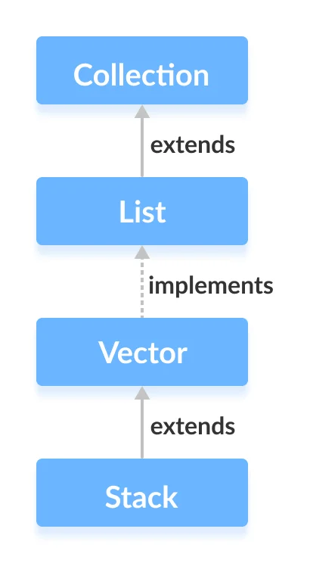
Java Stack Class
The Java collections framework has a class named Stack that provides the functionality of the stack data structure.
The Stack class extends the Vector class.

Slide 48
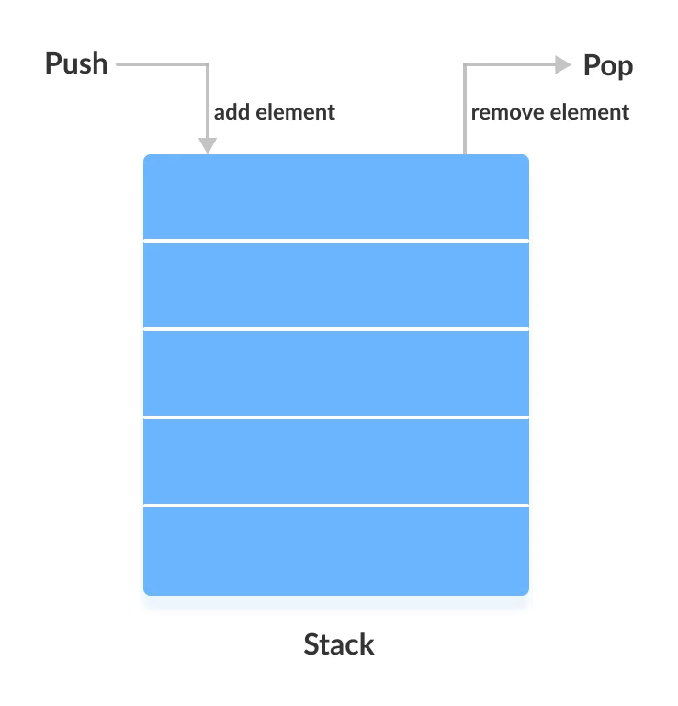
Stack Implementation
In stack, elements are stored and accessed in Last In First Out manner. That is, elements are added to the top of the stack and removed from the top of the stack.

Slide 49
Creating a Stack
In order to create a stack, we must import the java.util.Stack package first.
Here, Type indicates the stack's type.
Since Stack extends the Vector class, it inherits all the methods Vector. To learn about different Vector methods.
Besides these methods, the Stack class includes 5 more methods that distinguish it from Vector.
Stack<Type> stacks = new Stack<>();
// Create Integer type stack
Stack<Integer> stacks = new Stack<>();
// Create String type stack
Stack<String> stacks = new Stack<>();

Slide 50
Stack Methods
Methods | Descriptions
push() | To add an element to the top of the stack, we use the push() method.
pop() | To remove an element from the top of the stack, we use the pop() method.
peek() | The peek() method returns an object from the top of the stack.
search() | To search an element in the stack, we use the search() method. It returns the position of the element from the top of the stack.
empty() | To check whether a stack is empty or not, we use the empty() method.

Slide 51
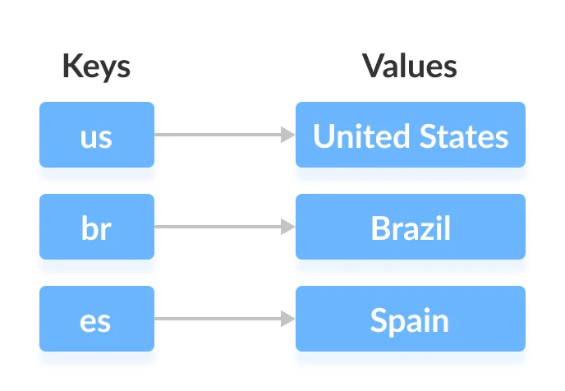
Java Map Interface
The Map interface of the Java collections framework provides the functionality of the map data structure.
Working of Map
In Java, elements of Map are stored in key/value pairs. Keys are unique values associated with individual Values.
A map cannot contain duplicate keys. And, each key is associated with a single value.
We can access and modify values using the keys associated with them.

Slide 52
The Map interface maintains 3 different sets:
the set of keys.
the set of values.
the set of key/value associations (mapping).
Hence we can access keys, values, and associations individually.

Slide 53
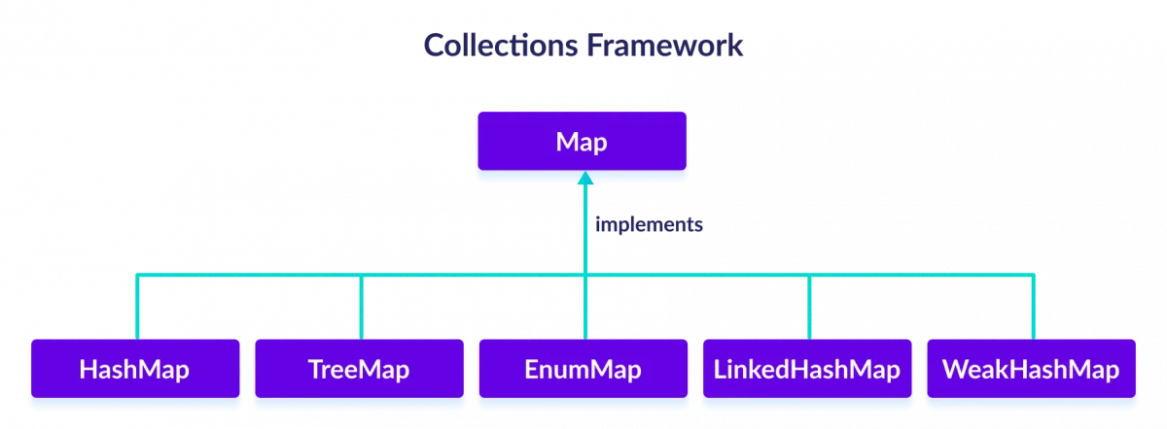
Since Map is an interface, we cannot create objects from it.
In order to use functionalities of the Map interface, we can use these classes:

Slide 54
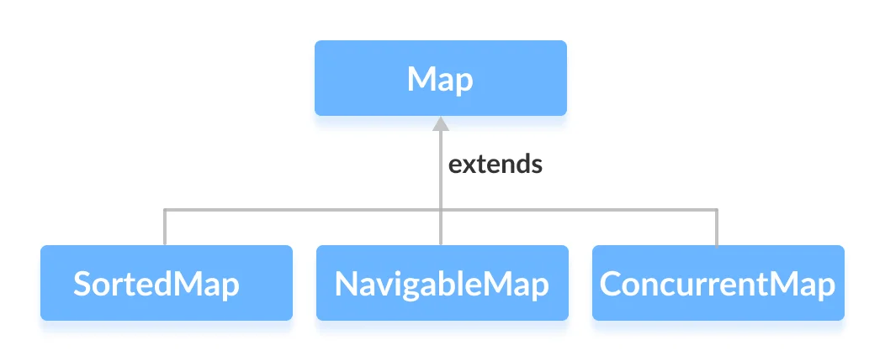
The Map interface is also extended by these subinterfaces:

Slide 55
How to use Map?
In Java, we must import the java.util.Map package in order to use Map. Once we import the package, here's how we can create a map.
Here,
Key - a unique identifier used to associate each element (value) in a map.
Value - elements associated by keys in a map.
// Map implementation using HashMap Map<Key, Value> numbers = new HashMap<>();

Slide 56
Methods of Map
The Map interface includes all the methods of the Collection interface. It is because Collection is a super interface of Map.
Besides methods available in the Collection interface, the Map interface also includes the following methods:
put(K, V) - Inserts the association of a key K and a value V into the map. If the key is already present, the new value replaces the old value.
putAll() - Inserts all the entries from the specified map to this map.
putIfAbsent(K, V) - Inserts the association if the key K is not already associated with the value V.
get(K) - Returns the value associated with the specified key K. If the key is not found, it returns null.

Slide 57
getOrDefault(K, defaultValue) - Returns the value associated with the specified key K. If the key is not found, it returns the defaultValue.
containsKey(K) - Checks if the specified key K is present in the map or not.
containsValue(V) - Checks if the specified value V is present in the map or not.
replace(K, V) - Replace the value of the key K with the new specified value V.
replace(K, oldValue, newValue) - Replaces the value of the key K with the new value newValue only if the key K is associated with the value oldValue.

Slide 58
remove(K) - Removes the entry from the map represented by the key K.
remove(K, V) - Removes the entry from the map that has key K associated with value V.
keySet() - Returns a set of all the keys present in a map.
values() - Returns a set of all the values present in a map.
entrySet() - Returns a set of all the key/value mapping present in a map.

Slide 59
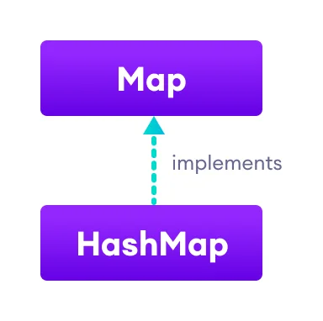
Java HashMap
The HashMap class of the Java collections framework provides the functionality of the hash table data structure.
It stores elements in key/value pairs. Here, keys are unique identifiers used to associate each value on a map.
The HashMap class implements the Map interface.

Slide 60
Create a HashMap
In order to create a hash map, we must import the java.util.HashMap package first.
In the above code, we have created a hashmap named numbers. Here, K represents the key type and V represents the type of values.
Here, the type of keys is String and the type of values is Integer.
HashMap<K, V> numbers = new HashMap<>();
HashMap<String, Integer> numbers = new HashMap<>();

Slide 61
Creation of Hashmap
import java.util.HashMap;
class Main {
public static void main(String[] args) {
// create a hashmap
HashMap<String, Integer> languages = new HashMap<>();
// add elements to hashmap
languages.put("Java", 8);
languages.put("JavaScript", 1);
languages.put("Python", 3);
System.out.println("HashMap: " + languages);
}
}

Slide 62
Basic Operations on Java HashMap
The HashMap class provides various methods to perform different operations on hashmaps.
HashMap<String, Integer> languages = new HashMap<>();
Add elements
languages.put("Java", 8);
Access elements
String value = languages.get(1);
System.out.println("Value at index 1: " + value);
Change elements
languages.replace(2, "C++");
Remove elements
String value = languages.remove(2);

Slide 63
Java HashMap getOrDefault()
Syntax:
The getDefault() method takes two parameters.
key - key whose mapped value is to be returned.
defaultValue - value which is returned if the mapping for the specified key is not found.
hashmap.get(Object key, V defaultValue)

Slide 64
Java HashMap keySet()
Syntax:
returns a set view of all the keys of the hashmap.
keySet() method returns a set view of all the keys present in the hashmap.
The keySet() method can also be used with the for-each loop to iterate through each key of the hashmap.
hashmap.keySet()
for(String key: numbers.keySet())
{
// print each key
System.out.print(key + ", ");
}

Slide 65
Java HashMap values()
Syntax:
It returns a collection view of all values of the hashmap.
The values() method can also be used with the for-each loop to iterate through each value of the hashmap.
hashmap.values()
for(int value: numbers.values())
{
// print each value System.out.print(value + ", ");
}

Slide 66
Java HashMap entrySet()
Syntax:
It returns a set view of all the entries of a hashmap.
The entrySet() method returns a set view of all the entries from the hashmap.
The entrySet() method can be used with the for-each loop to iterate through each entry of the hashmap.
hashmap.entrySet()
for(Entry<String, Integer> entry: numbers.entrySet())
{
System.out.print(entry);
System.out.print(", ");
}

Slide 67
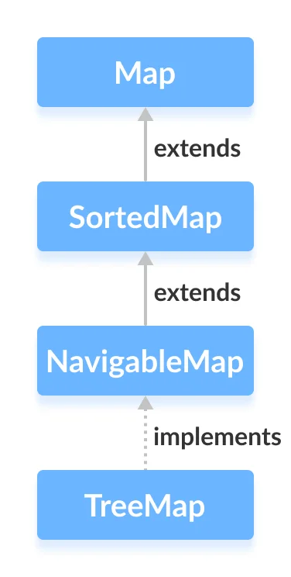
Java TreeMap
The TreeMap class of the Java collections framework provides the tree data structure implementation.
It implements the NavigableMap interface.

Slide 68
Creating a TreeMap
In order to create a TreeMap, we must import the java.util.TreeMap package first.
In the above code, we have created a TreeMap named numbers without any arguments. In this case, the elements in TreeMap are sorted naturally (ascending order).
However, we can customize the sorting of elements by using the Comparator interface.
TreeMap<Key, Value> numbers = new TreeMap<>();

Slide 69
Methods of TreeMap
The TreeMap class provides various methods that allow us to perform operations on the map.
Insert Elements to TreeMap
Methods | Description
put() | Inserts the specified key/value mapping (entry) to the map
putAll() | Inserts all the entries from specified map to this map
putIfAbsent() | Inserts the specified key/value mapping to the map if the specified key is not present in the map

Slide 70
Example
import java.util.TreeMap;
class Main {
public static void main(String[] args) {
// Creating TreeMap of even numbers
TreeMap<String, Integer> evenNumbers = new TreeMap<>();
// Using put()
evenNumbers.put("Two", 2);
evenNumbers.put("Four", 4);
// Using putIfAbsent()
evenNumbers.putIfAbsent("Six", 6);
System.out.println("TreeMap of even numbers: " + evenNumbers);
//Creating TreeMap of numbers
TreeMap<String, Integer> numbers = new TreeMap<>();
numbers.put("One", 1);
// Using putAll()
numbers.putAll(evenNumbers);
System.out.println("TreeMap of numbers: " + numbers);
}
}

Slide 71
Access TreeMap Elements
Methods | Description
entrySet() | returns a set of all the key/values mapping (entry) of a treemap.
keySet() | returns a set of all the keys of a tree map.
values() | returns a set of all the maps of a tree map

Slide 72
Example
import java.util.TreeMap;
class Main {
public static void main(String[] args) {
TreeMap<String, Integer> numbers = new TreeMap<>();
numbers.put("One", 1);
numbers.put("Two", 2);
numbers.put("Three", 3);
System.out.println("TreeMap: " + numbers);
// Using entrySet()
System.out.println("Key/Value mappings: " + numbers.entrySet());
// Using keySet()
System.out.println("Keys: " + numbers.keySet());
// Using values()
System.out.println("Values: " + numbers.values());
}
}

Slide 73
Using get() and getOrDefault()
get() - Returns the value associated with the specified key. Returns null if the key is not found.
getOrDefault() - Returns the value associated with the specified key. Returns the specified default value if the key is not found.
Remove TeeMap Elements
remove(key) - returns and removes the entry associated with the specified key from a TreeMap.
remove(key, value) - removes the entry from the map only if the specified key is associated with the specified value and returns a boolean value.

Slide 74
Replace TreeMap Elements
replace(key, value) - replaces the value mapped by the specified key with the new value
replace(key, old, new) - replaces the old value with the new value only if the old value is already associated with the specified key
replaceAll(function) - replaces each value of the map with the result of the specified function

Slide 75
Example
import java.util.TreeMap;
class Main {
public static void main(String[] args) {
TreeMap<String, Integer> numbers = new TreeMap<>();
numbers.put("First", 1);
numbers.put("Second", 2);
numbers.put("Third", 3);
System.out.println("Original TreeMap: " + numbers);
// Using replace()
numbers.replace("Second", 22);
numbers.replace("Third", 3, 33);
System.out.println("TreeMap using replace: " + numbers);
// Using replaceAll()
numbers.replaceAll((key, oldValue) -> oldValue + 2);
System.out.println("TreeMap using replaceAll: " + numbers);
}
}

Slide 76
Since the TreeMap class implements NavigableMap, it provides various methods to navigate over the elements of the treemap.
First and Last Methods
firstKey() - returns the first key of the map.
firstEntry() - returns the key/value mapping of the first key of the map.
lastKey() - returns the last key of the map.
lastEntry() - returns the key/value mapping of the last key of the map.

Slide 77
Example
import java.util.TreeMap;
class Main {
public static void main(String[] args) {
TreeMap<String, Integer> numbers = new TreeMap<>();
numbers.put("First", 1);
numbers.put("Second", 2);
numbers.put("Third", 3);
System.out.println("TreeMap: " + numbers);
// Using the firstKey() method
String firstKey = numbers.firstKey();
System.out.println("First Key: " + firstKey);
// Using the lastKey() method
String lastKey = numbers.lastKey();
System.out.println("Last Key: " + lastKey);
// Using firstEntry() method
System.out.println("First Entry: " + numbers.firstEntry());
// Using the lastEntry() method
System.out.println("Last Entry: " + numbers.lastEntry());
}
}

Slide 78
Ceiling, Floor, Higher and Lower Methods
higherKey() - Returns the lowest key among those keys that are greater than the specified key.
higherEntry() - Returns an entry associated with a key that is lowest among all those keys greater than the specified key.
lowerKey() - Returns the greatest key among all those keys that are less than the specified key.
lowerEntry() - Returns an entry associated with a key that is greatest among all those keys that are less than the specified key.
ceilingKey() - Returns the lowest key among those keys that are greater than the specified key. If the key passed as an argument is present in the map, it returns that key.
ceilingEntry() - Returns an entry associated with a key that is lowest among those keys that are greater than the specified key. It an entry associated with the key passed an argument is present in the map, it returns the entry associated with that key.
floorKey() - Returns the greatest key among those keys that are less than the specified key. If the key passed as an argument is present, it returns that key.
floorEntry() - Returns an entry associated with a key that is greatest among those keys that are less than the specified key. If the key passed as argument is present, it returns that key.

Slide 79
Example
import java.util.TreeMap;
class Main {
public static void main(String[] args) {
TreeMap<String, Integer> numbers = new TreeMap<>();
numbers.put("First", 1);
numbers.put("Second", 5);
numbers.put("Third", 4);
numbers.put("Fourth", 6);
System.out.println("TreeMap: " + numbers);
// Using higher()
System.out.println("Using higherKey(): " + numbers.higherKey("Fourth"));
System.out.println("Using higherEntry(): " + numbers.higherEntry("Fourth"));
// Using lower()
System.out.println("\nUsing lowerKey(): " + numbers.lowerKey("Fourth"));
System.out.println("Using lowerEntry(): " + numbers.lowerEntry("Fourth"));
// Using ceiling()
System.out.println("\nUsing ceilingKey(): " + numbers.ceilingKey("Fourth"));
System.out.println("Using ceilingEntry(): " + numbers.ceilingEntry("Fourth"));
// Using floor()
System.out.println("\nUsing floorKey(): " + numbers.floorKey("Fourth"));
System.out.println("Using floorEntry(): " + numbers.floorEntry("Fourth"));
}
}

Slide 80
pollFirstEntry() and pollLastEntry() Methods
pollFirstEntry() - returns and removes the entry associated with the first key of the map
pollLastEntry() - returns and removes the entry associated with the last key of the map

Slide 81
Example
import java.util.TreeMap;
class Main {
public static void main(String[] args) {
TreeMap<String, Integer> numbers = new TreeMap<>();
numbers.put("First", 1);
numbers.put("Second", 2);
numbers.put("Third", 3);
System.out.println("TreeMap: " + numbers);
//Using the pollFirstEntry() method
System.out.println("Using pollFirstEntry(): " + numbers.pollFirstEntry());
// Using the pollLastEntry() method
System.out.println("Using pollLastEntry(): " + numbers.pollLastEntry());
System.out.println("Updated TreeMap: " + numbers);
}
}

Slide 82
headMap(), tailMap() and subMap() Methods
headMap(key, booleanValue)
The headMap() method returns all the key/value pairs of a treemap before the specified key (which is passed as an argument).
The booleanValue parameter is optional. Its default value is false.
If true is passed as a booleanValue, the method also includes the key/value pair of the key which is passed as an argument.

Slide 83
Example
import java.util.TreeMap;
class Main {
public static void main(String[] args) {
TreeMap<String, Integer> numbers = new TreeMap<>();
numbers.put("First", 1);
numbers.put("Second", 2);
numbers.put("Third", 3);
numbers.put("Fourth", 4);
System.out.println("TreeMap: " + numbers);
System.out.println("\nUsing headMap() Method:");
// Using headMap() with default booleanValue
System.out.println("Without boolean value: " + numbers.headMap("Fourth"));
// Using headMap() with specified booleanValue
System.out.println("With boolean value: " + numbers.headMap("Fourth", true));
}
}

Slide 84
tailMap(key, booleanValue)
The tailMap() method returns all the key/value pairs of a treemap starting from the specified key (which is passed as an argument).
The booleanValue is an optional parameter. Its default value is true.
If false is passed as a booleanValue, the method doesn't include the key/value pair of the specified key.

Slide 85
Example
import java.util.TreeMap;
class Main {
public static void main(String[] args) {
TreeMap<String, Integer> numbers = new TreeMap<>();
numbers.put("First", 1);
numbers.put("Second", 2);
numbers.put("Third", 3);
numbers.put("Fourth", 4);
System.out.println("TreeMap: " + numbers);
System.out.println("\nUsing tailMap() Method:");
// Using tailMap() with default booleanValue
System.out.println("Without boolean value: " + numbers.tailMap("Second"));
// Using tailMap() with specified booleanValue
System.out.println("With boolean value: " + numbers.tailMap("Second", false));
}
}

Slide 86
subMap(k1, bV1, k2, bV2)
The subMap() method returns all the entries associated with keys between k1 and k2including the entry of k1.
The bV1 and bV2 are optional boolean parameters. The default value of bV1 is trueand the default value of bV2 is false.
If false is passed as bV1, the method returns all the entries associated with keys between k1 and k2 without including the entry of k1.
If true is passed as bV2, the method returns all the entries associated with keys between k1 and k2 including the entry of k2

Slide 87
Example
import java.util.TreeMap;
class Main {
public static void main(String[] args) {
TreeMap<String, Integer> numbers = new TreeMap<>();
numbers.put("First", 1);
numbers.put("Second", 2);
numbers.put("Third", 3);
numbers.put("Fourth", 4);
System.out.println("TreeMap: " + numbers);
System.out.println("\nUsing subMap() Method:");
// Using subMap() with default booleanValue
System.out.println("Without boolean value: " + numbers.subMap("Fourth", "Third"));
// Using subMap() with specified booleanValue
System.out.println("With boolean value: " + numbers.subMap("Fourth", false, "Third", true));
}
}

Slide 88
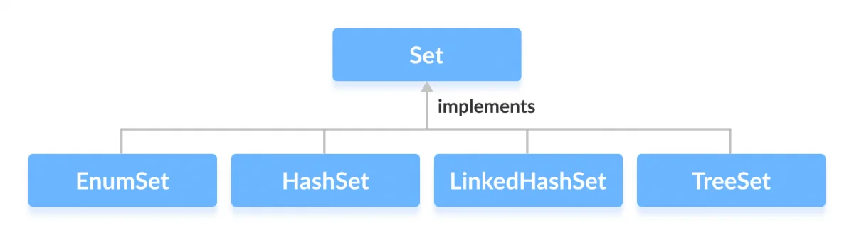
Java Set Interface
The Set interface of the Java Collections framework provides the features of the mathematical set in Java. It extends the Collection interface.
Since Set is an interface, we cannot create objects from it.
In order to use functionalities of the Set interface, we can use these classes:

Slide 89
How to use Set?
In Java, we must import java.util.Set package in order to use Set.
The Set interface includes all the methods of the Collection interface. It's because Collection is a super interface of Set.
// Set implementation using HashSet
Set<String> animals = new HashSet<>();

Slide 90
Set Operations
The Java Set interface allows us to perform basic mathematical set operations like union, intersection, and subset.
Union - to get the union of two sets x and y, we can use x.addAll(y)
Intersection - to get the intersection of two sets x and y, we can use x.retainAll(y)
Subset - to check if x is a subset of y, we can use y.containsAll(x)

Slide 91
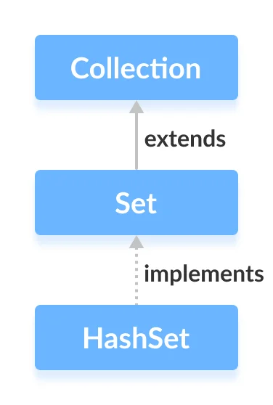
Java HashSet Class
The HashSet class of the Java Collections framework provides the functionalities of the hash table data structure.
It implements the Set interface.

Slide 92
Why Hashset?
In Java, HashSet is commonly used if we have to access elements randomly. It is because elements in a hash table are accessed using hash codes.
The hashcode of an element is a unique identity that helps to identify the element in a hash table.
HashSet cannot contain duplicate elements. Hence, each hash set element has a unique hashcode.

Slide 93
Creating a HashSet
In order to create a hash set, we must import the java.util.HashSet package first.
capacity - The capacity of this hash set is 8. Meaning, it can store 8 elements.
loadFactor - The load factor of this hash set is 0.6. This means, whenever our hash set is filled by 60%, the elements are moved to a new hash table of double the size of the original hash table.
// HashSet with 8 capacity and 0.75 load factor HashSet
<Integer> numbers = new HashSet<>(8, 0.75);

Slide 94
Default capacity and load factor
It's possible to create a hash table without defining its capacity and load factor.
By default,
the capacity of the hash set will be 16.
the load factor will be 0.75.
// HashSet with default capacity and load factor HashSet<Integer> numbers1 = new HashSet<>();

Slide 95
Union of Sets To perform the union between two sets, we can use the addAll() method
import java.util.HashSet;
class Main {
public static void main(String[] args) {
HashSet<Integer> evenNumbers = new HashSet<>();
evenNumbers.add(2);
evenNumbers.add(4);
System.out.println("HashSet1: " + evenNumbers);
HashSet<Integer> numbers = new HashSet<>();
numbers.add(1);
numbers.add(3);
System.out.println("HashSet2: " + numbers);
// Union of two set
numbers.addAll(evenNumbers);
System.out.println("Union is: " + numbers);
}
}

Slide 96
Intersection of Sets
To perform the intersection between two sets, we can use the retainAll() method.
import java.util.HashSet;
class Main {
public static void main(String[] args) {
HashSet<Integer> primeNumbers = new HashSet<>();
primeNumbers.add(2);
primeNumbers.add(3);
System.out.println("HashSet1: " + primeNumbers);
HashSet<Integer> evenNumbers = new HashSet<>();
evenNumbers.add(2);
evenNumbers.add(4);
System.out.println("HashSet2: " + evenNumbers);
// Intersection of two sets
evenNumbers.retainAll(primeNumbers);
System.out.println("Intersection is: " + evenNumbers);
}
}

Slide 97
Difference of Sets
To calculate the difference between the two sets, we can use the removeAll() method.
import java.util.HashSet;
class Main {
public static void main(String[] args) {
HashSet<Integer> primeNumbers = new HashSet<>();
primeNumbers.add(2);
primeNumbers.add(3);
primeNumbers.add(5);
System.out.println("HashSet1: " + primeNumbers);
HashSet<Integer> oddNumbers = new HashSet<>();
oddNumbers.add(1);
oddNumbers.add(3);
oddNumbers.add(5);
System.out.println("HashSet2: " + oddNumbers);
// Difference between HashSet1 and HashSet2
primeNumbers.removeAll(oddNumbers);
System.out.println("Difference : " + primeNumbers);
}
}

Slide 98
Subset : To check if a set is a subset of another set or not, we can use the containsAll() method.
import java.util.HashSet;
class Main {
public static void main(String[] args) {
HashSet<Integer> numbers = new HashSet<>();
numbers.add(1);
numbers.add(2);
numbers.add(3);
numbers.add(4);
System.out.println("HashSet1: " + numbers);
HashSet<Integer> primeNumbers = new HashSet<>();
primeNumbers.add(2);
primeNumbers.add(3);
System.out.println("HashSet2: " + primeNumbers);
// Check if primeNumbers is a subset of numbers
boolean result = numbers.containsAll(primeNumbers);
System.out.println("Is HashSet2 is subset of HashSet1? " + result);
}
}

Slide 99
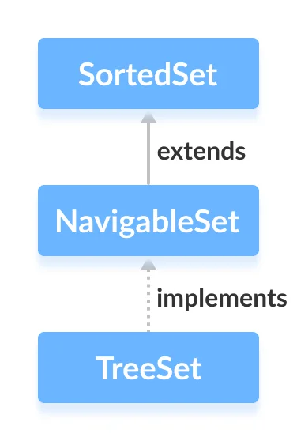
Java NavigableSet Interface
The NavigableSet interface of the Java Collections framework provides the features to navigate among the set elements.
In order to use the functionalities of the NavigableSet interface, we need to use the TreeSet class that implements NavigableSet.

Slide 100
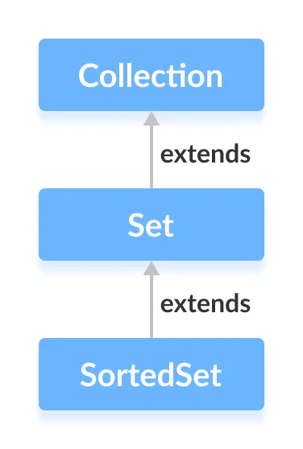
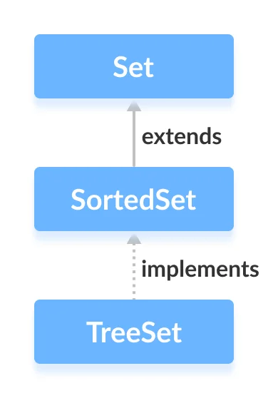
Java SortedSet Interface
The SortedSet interface of the Java Collections framework is used to store elements with some order in a set.
It extends the Set interface.
In order to use the functionalities of the SortedSet interface, we need to use the TreeSetclass that implements it.

Slide 101
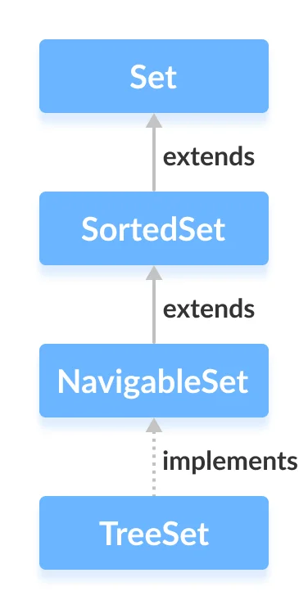
Java TreeSet
The TreeSet class of the Java collections framework provides the functionality of a tree data structure.
It extends the NavigableSet interface.

Slide 102
Creating a TreeSet
In order to create a tree set, we must import the java.util.TreeSet package first.
Here, we have created a TreeSet without any arguments. In this case, the elements in TreeSet are sorted naturally (ascending order).
However, we can customize the sorting of elements by using the Comparator interface.
TreeSet<Integer> numbers = new TreeSet<>();

Slide 103
Access TreeSet Elements
To access the elements of a tree set, we can use the iterator() method. In order to use this method, we must import java.util.Iterator package.
import java.util.TreeSet;
import java.util.Iterator;
class Main {
public static void main(String[] args) {
TreeSet<Integer> numbers = new TreeSet<>();
numbers.add(2);
numbers.add(5);
numbers.add(6);
System.out.println("TreeSet: " + numbers);
// Calling iterator() method
Iterator<Integer> iterate = numbers.iterator();
System.out.print("TreeSet using Iterator: ");
// Accessing elements
while(iterate.hasNext()) {
System.out.print(iterate.next());
System.out.print(", ");
}
}
}

Slide 104
Methods for Navigation
Since the TreeSet class implements NavigableSet, it provides various methods to navigate over the elements of the tree set.
first() and last() Methods
first() - returns the first element of the set
last() - returns the last element of the set

Slide 105
Example
import java.util.TreeSet;
class Main {
public static void main(String[] args) {
TreeSet<Integer> numbers = new TreeSet<>();
numbers.add(2);
numbers.add(5);
numbers.add(6);
System.out.println("TreeSet: " + numbers);
// Using the first() method
int first = numbers.first();
System.out.println("First Number: " + first);
// Using the last() method
int last = numbers.last();
System.out.println("Last Number: " + last);
}
}

Slide 106
ceiling(), floor(), higher() and lower() Methods
higher(element) - Returns the lowest element among those elements that are greater than the specified element.
lower(element) - Returns the greatest element among those elements that are less than the specified element.
ceiling(element) - Returns the lowest element among those elements that are greater than the specified element. If the element passed exists in a tree set, it returns the element passed as an argument.
floor(element) - Returns the greatest element among those elements that are less than the specified element. If the element passed exists in a tree set, it returns the element passed as an argument.

Slide 107
Example
import java.util.TreeSet;
class Main {
public static void main(String[] args) {
TreeSet<Integer> numbers = new TreeSet<>();
numbers.add(2);
numbers.add(5);
numbers.add(4);
numbers.add(6);
System.out.println("TreeSet: " + numbers);
// Using higher()
System.out.println("Using higher: " + numbers.higher(4));
// Using lower()
System.out.println("Using lower: " + numbers.lower(4));
// Using ceiling()
System.out.println("Using ceiling: " + numbers.ceiling(4));
// Using floor()
System.out.println("Using floor: " + numbers.floor(3));
}
}

Slide 108
pollfirst() and pollLast() Methods
pollFirst() - returns and removes the first element from the set
pollLast() - returns and removes the last element from the set

Slide 109
Example
import java.util.TreeSet;
class Main {
public static void main(String[] args) {
TreeSet<Integer> numbers = new TreeSet<>();
numbers.add(2);
numbers.add(5);
numbers.add(4);
numbers.add(6);
System.out.println("TreeSet: " + numbers);
// Using pollFirst()
System.out.println("Removed First Element: " + numbers.pollFirst());
// Using pollLast()
System.out.println("Removed Last Element: " + numbers.pollLast());
System.out.println("New TreeSet: " + numbers);
}
}

Slide 110
headSet(element, booleanValue)
The headSet() method returns all the elements of a tree set before the specified element(which is passed as an argument).
The booleanValue parameter is optional. Its default value is false.
If true is passed as a booleanValue, the method returns all the elements before the specified element including the specified element.

Slide 111
Example
import java.util.TreeSet;
class Main {
public static void main(String[] args) {
TreeSet<Integer> numbers = new TreeSet<>();
numbers.add(2);
numbers.add(5);
numbers.add(4);
numbers.add(6);
System.out.println("TreeSet: " + numbers);
// Using headSet() with default boolean value
System.out.println("Using headSet without boolean value: " + numbers.headSet(5));
// Using headSet() with specified boolean value
System.out.println("Using headSet with boolean value: " + numbers.headSet(5, true));
}
}

Slide 112
tailSet(element, booleanValue)
The tailSet() method returns all the elements of a tree set after the specified element(which is passed as a parameter) including the specified element.
The booleanValue parameter is optional. Its default value is true.
If false is passed as a booleanValue, the method returns all the elements after the specified element without including the specified element.

Slide 113
Example
import java.util.TreeSet;
class Main {
public static void main(String[] args) {
TreeSet<Integer> numbers = new TreeSet<>();
numbers.add(2);
numbers.add(5);
numbers.add(4);
numbers.add(6);
System.out.println("TreeSet: " + numbers);
// Using tailSet() with default boolean value
System.out.println("Using tailSet without boolean value: " + numbers.tailSet(4));
// Using tailSet() with specified boolean value
System.out.println("Using tailSet with boolean value: " + numbers.tailSet(4, false));
}
}

Slide 114
subSet(e1, bv1, e2, bv2)
The subSet() method returns all the elements between e1 and e2 including e1.
The bv1 and bv2 are optional parameters. The default value of bv1 is true, and the default value of bv2 is false.
If false is passed as bv1, the method returns all the elements between e1 and e2without including e1.
If true is passed as bv2, the method returns all the elements between e1 and e2, including e1.

Slide 115
Example
import java.util.TreeSet;
class Main {
public static void main(String[] args) {
TreeSet<Integer> numbers = new TreeSet<>();
numbers.add(2);
numbers.add(5);
numbers.add(4);
numbers.add(6);
System.out.println("TreeSet: " + numbers);
// Using subSet() with default boolean value
System.out.println("Using subSet without boolean value: " + numbers.subSet(4, 6));
// Using subSet() with specified boolean value
System.out.println("Using subSet with boolean value: " + numbers.subSet(4, false, 6, true));
}
}

Slide 116
We can perform the all set operations as discussed in Hashset.
Union
Intersection
Difference
Subset

Slide 117
TreeSet Vs. HashSet
Both the TreeSet as well as the HashSet implements the Set interface. However, there exist some differences between them.
Unlike HashSet, elements in TreeSet are stored in some order. It is because TreeSetimplements the SortedSet interface as well.
TreeSet provides some methods for easy navigation. For example, first(), last(), headSet(), tailSet(), etc. It is because TreeSet also implements the NavigableSetinterface.
HashSet is faster than the TreeSet for basic operations like add, remove, contains and size.

